Slide 1



Query Squad
A PRESENTATION BY:
SURYA KALYANARAMAN (TEAM LEAD)
VIMALA SENTHILVADIVEL
POORNIMA S M
CHANDANA T S SMPO:
AMITHA SRIDHAR SUNITHA GIDUTHURI

Slide 2





Overview
Diabetic Database
Postgre
SQL
Jira
Github

Slide 3

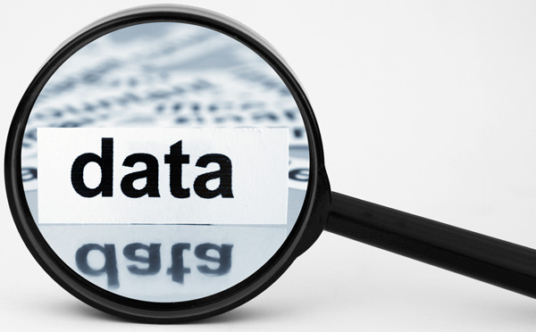
Diabetes Data
Consists of 15 tables of 77 patient's records.
Patients are divided into diabetic and control groups.
Includes lab records related to diabetes, dementia, heart rate, and blood pressure.
Dataset allows for analysis and comparison of key parameters.

Slide 4

FUNCTIONS
ORDER BY RANDOM()
EXTRACT(YEAR FROM CURRENT_DATE)
FLOOR
ROW_NUMBER() OVER (ORDER BY())
WIDTH BUCKET
RAISE NOTICE
ARRAY_AGG
CEILING
INSTEAD OF
DENSE_RANK
POSITION

Slide 5
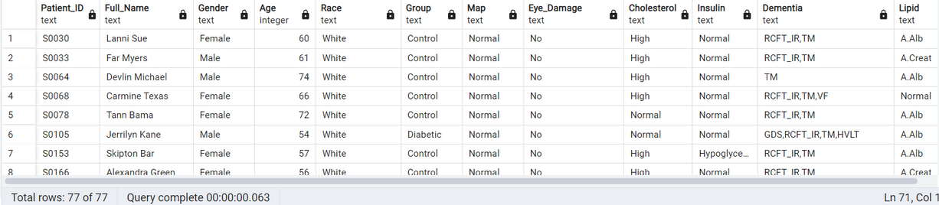
Comprehensive Study
Explored 13 tables together to provide a holistic examination of the dataset.
Variables analyzed include age, race, gender.
Analysis involved range studies of MAP, eye damage, cholesterol, fasting glucose, and dementia tests.
Used SQL to explore relationships and connections among these variables.
Uncovered valuable insights into how the variables interact with each other.
Identified conditions based on the derived ranges.

Slide 6

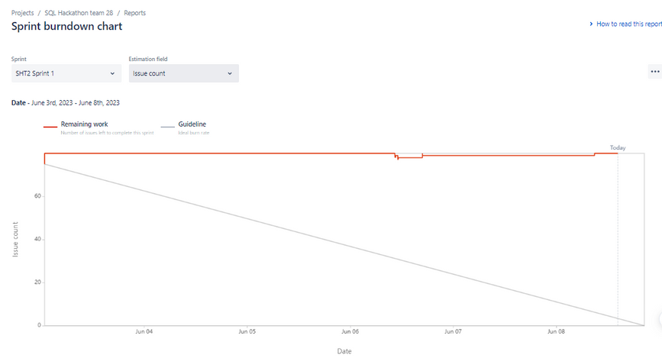
Learning
Analyzing the data
Domain Knowledge
Medical Insights
Team Work
Performance Optimization
Agile Methodology
Graphic Visualization
New Functions
GitHub Collaboration

